Slide 1
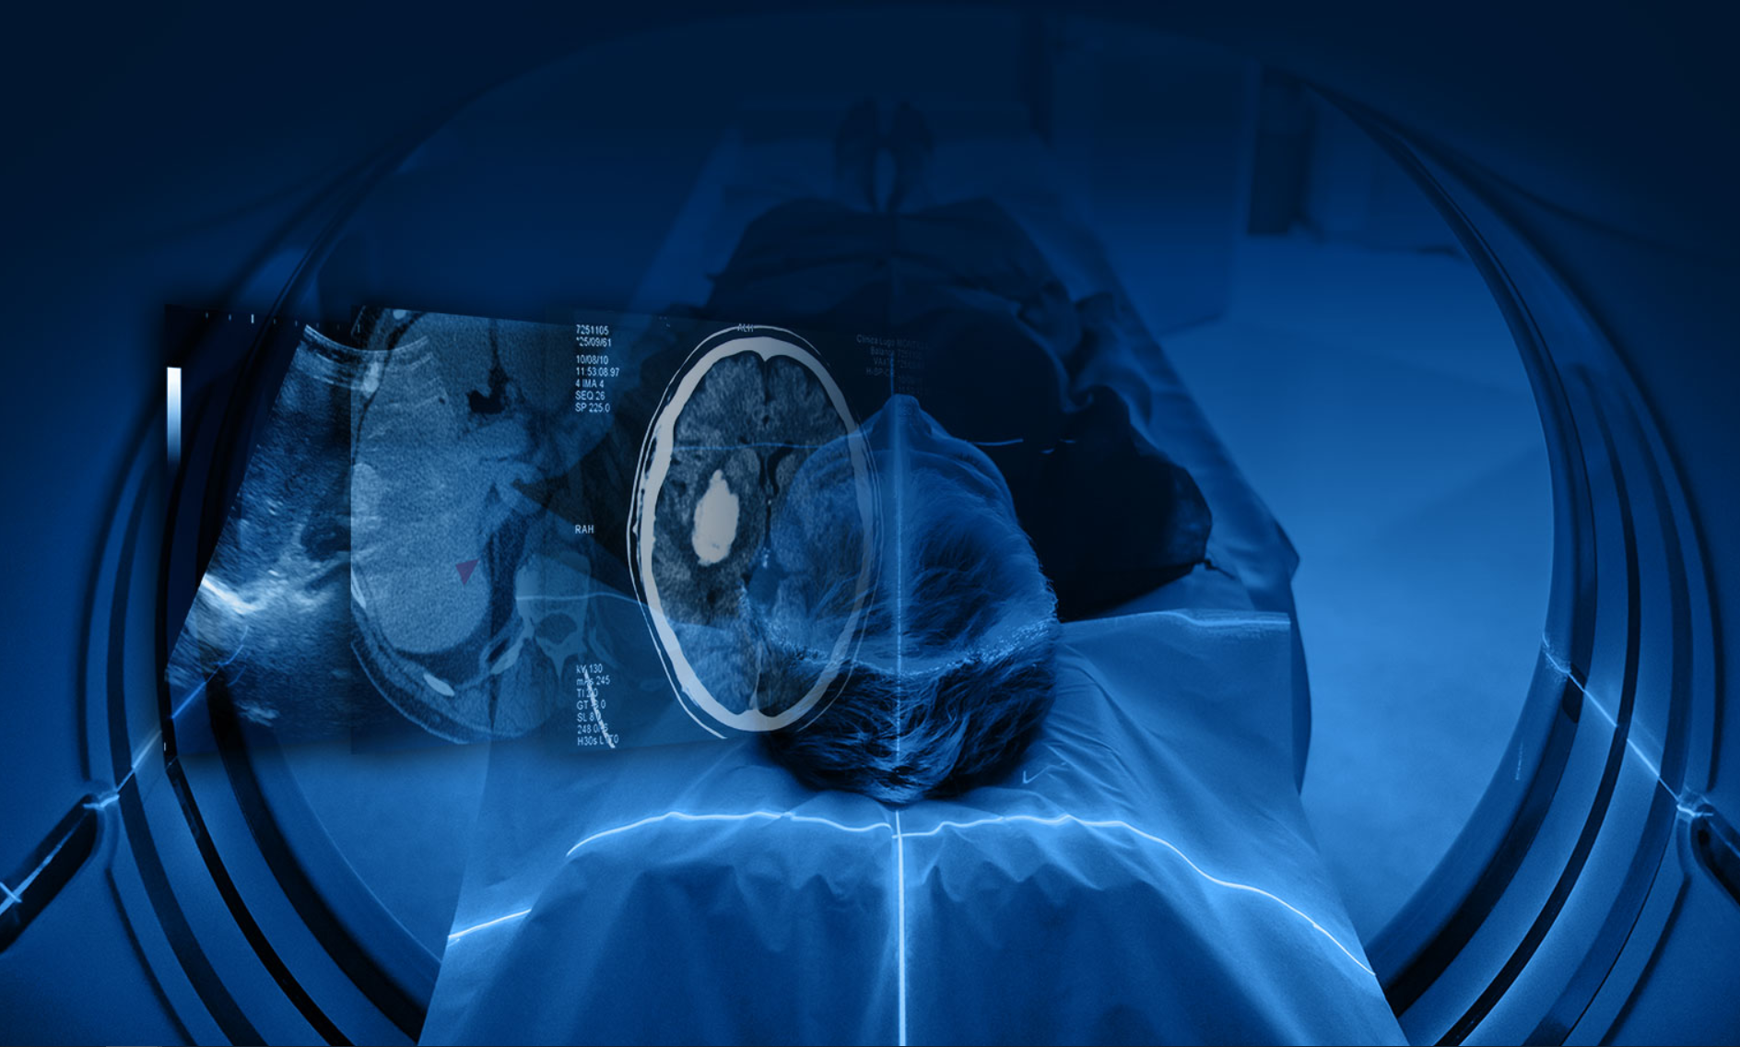

RSNA Deep Learning Lab for The Cancer Imaging Archive 12-03-2024
Justin Kirby
Technical Project Manager
Cancer Imaging Informatics Lab
Email: justin.kirby@nih.gov

Slide 2

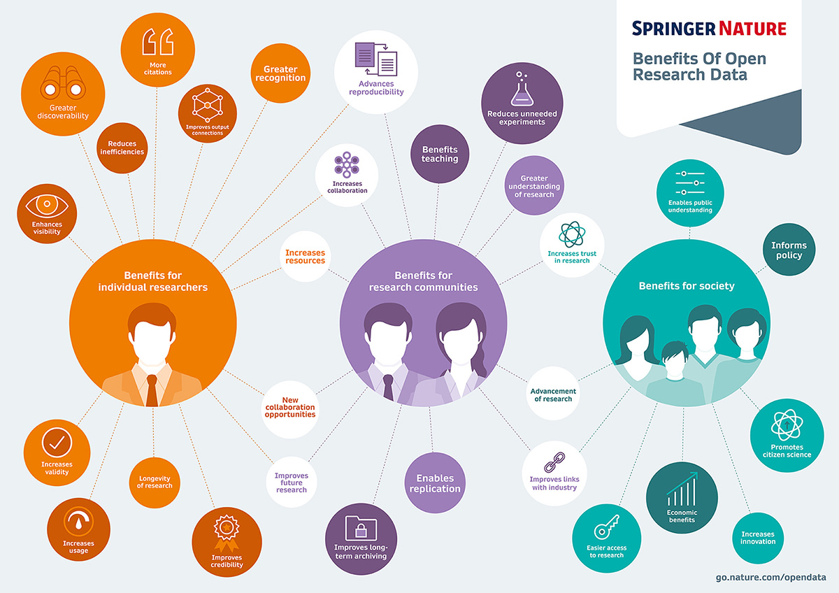
Data sharing enables better science

Slide 3
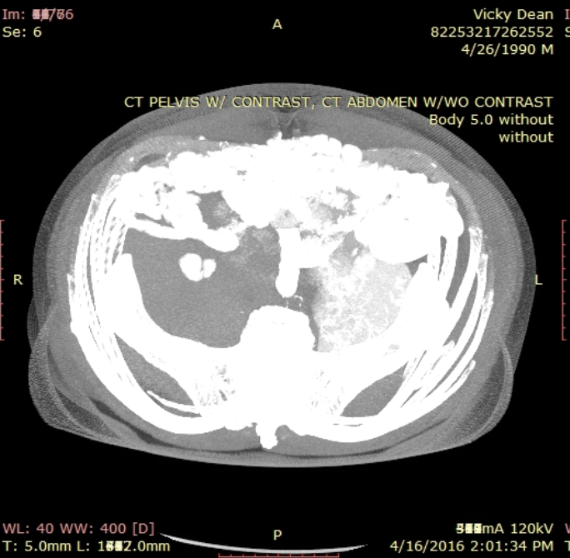
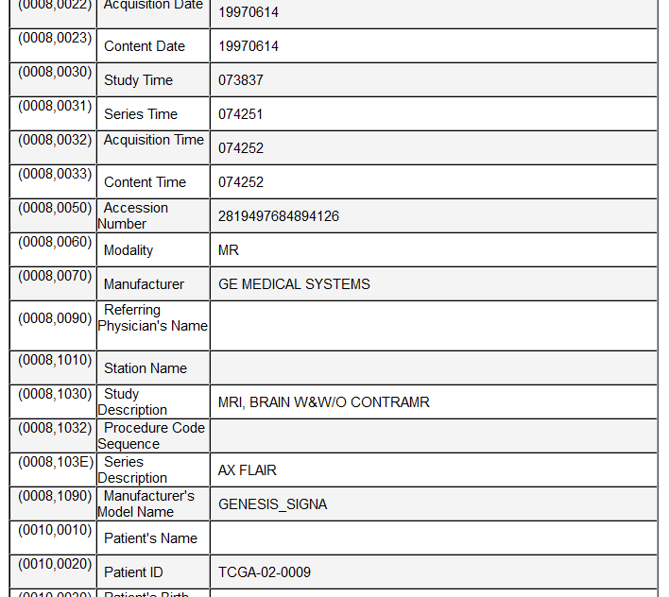
Sharing radiology data isn’t easy!
PHI can appear in hundreds of places in DICOM
Pixel data
Dates
Identifiers
Descriptions
“Private tags” with ambiguous proprietary content
Simplistic de-id approaches throw away important acquisition metadata that prevents reuse
Convert data to NIFTI, PNG, JPEG
Retain DICOM, but use overly aggressive cleaning methods

Slide 4
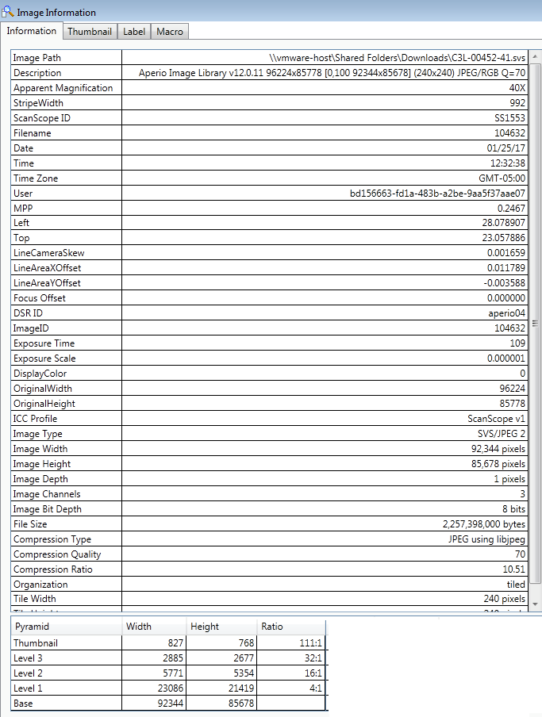
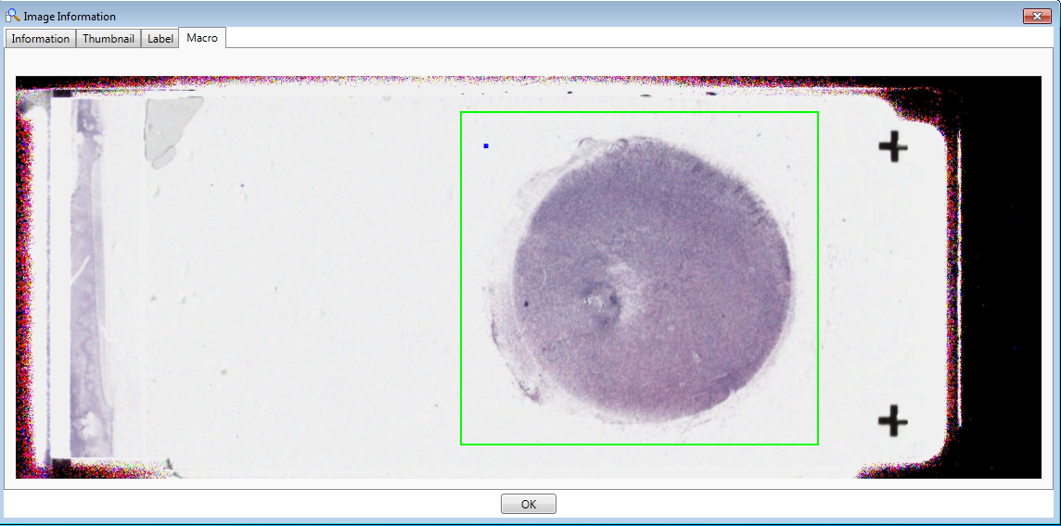
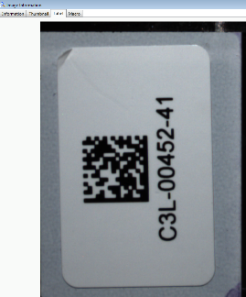
Histopathology image de-identification
Image metadata
Image labels/barcodes/macro images
Pixel data
Proprietary formats means using various tools
for curation
Jane Doe
Dx = AML

Slide 5
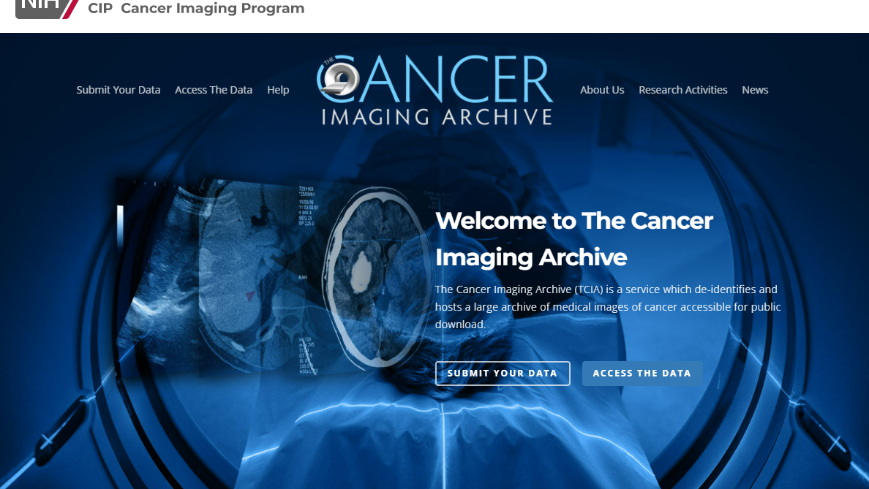

Slide 6






Funding, Governance, Implementation
Funding and Governance
Management and implementation
Subcontract implementation
Cancer Imaging Informatics Lab
Notes:
Funded and governed by NCI/CIP/DCTD, managed by FNLCR, and implemented in collaboration with several subcontractors.

Slide 7
TCIA Services
De-identification and Quality Assurance Process.
Live Submission Support from beginning to end.
Reliable, Persistent Hosting
Data citations for findability and academic credit
Dedicated Curation Teams
Custom De-identification Software configured and installed at sites
Full documentation and Training
IRB coverage and Data agreements

Slide 8
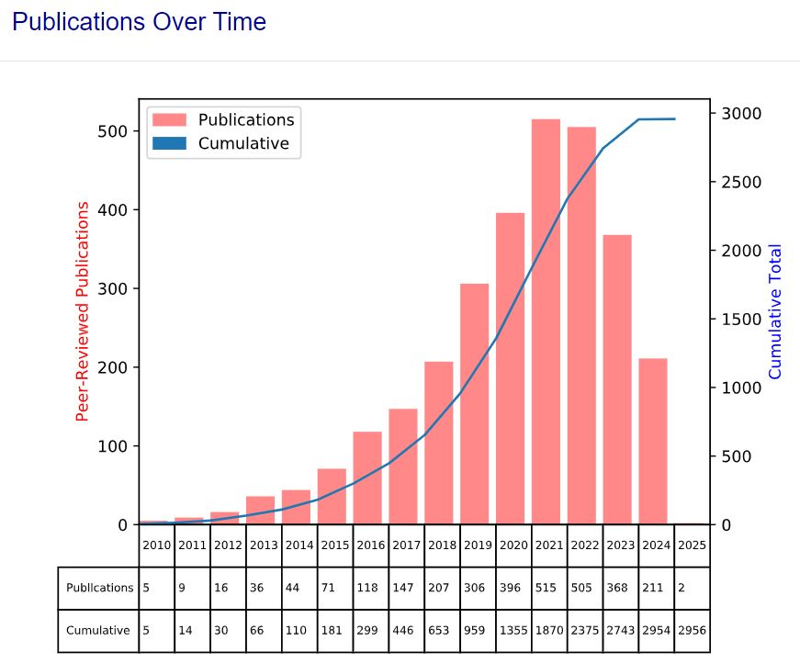
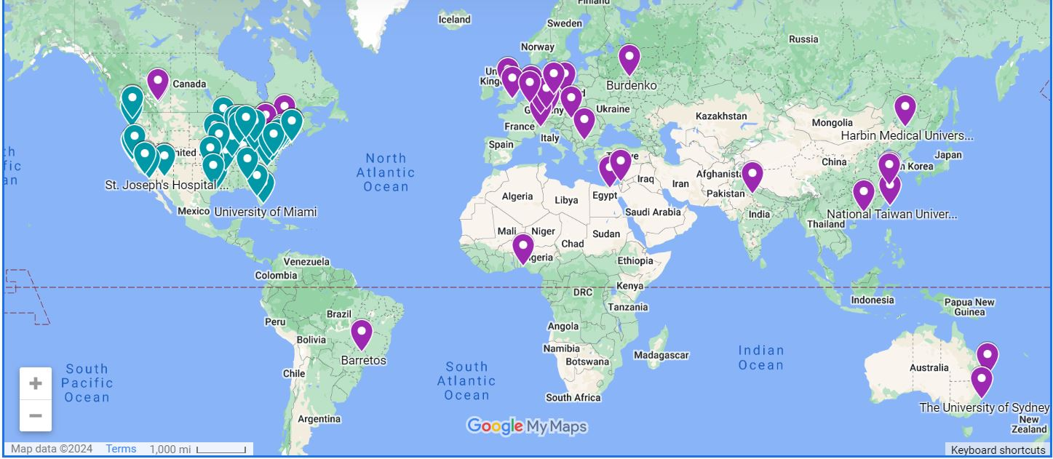
Scientific Impact of data sharing on TCIA
Publications are tracked monthly
200+ highly curated, de-identified research-focused cancer imaging datasets
3,000 peer-reviewed research publications have used TCIA data
Data contributed from 121 contributing institutions
21,000 monthly visitors
300TB of imaging data downloaded each month
Recommended repository of Nature, PLOS One, Medical Physics, Elsevier
Train/Test data for > 27 Patents
Research Data for > 29 NCI Grants
121 Contributing Institutions
Over 50 new AI and machine learning peer-reviewed articles using TCIA data have been published in the last year alone.

Slide 9
Investigator-initiated Proposals to share data on TCIA
An open-source, curated MRI dataset of metastatic breast cancer to the brain with expert-reviewed segmentations and tumor-derived radiomic features
MR imaging and segmentations with matched brain biopsy pathology slides from patients with brain metastases from primary lung cancer
The UCSD annotated post-treatment high-grade glioma multimodal MRI dataset
Expanding the brain tumor segmentation (brats) data to include African populations
High grade serous carcinoma precursor lesion digital slide images
Multi-scale signaling and tumor evolution in high-grade gliomas
More than half of TCIA datasets come from researcher-initiated data sharing proposals
CIP’s TCIA Advisory Group meets quarterly
Experts from NCI Cancer Imaging Program, Cancer Diagnosis Program, and Center for Cancer Research
Evaluation criteria:
Support Research reproducibility
Fill data gaps for critical current research for a clinical need
Provide novel/unique datasets to support scientific conclusions or hypothesis development
Test biological hypotheses or proposed discoveries about the patho-physiological basis of cancer
Researchers want to share…
Data generated by NCI/NIH Grants
Data used or generated by challenge competitions
Publication data sharing requirements
Example of Recently Approved Datasets
Notes:
TCIA also accepts community proposals to share data. And Advisory group evaluates proposals monthly, representation from various parts of NCI/FNLCR. Categories of proposals tend to be data sharing requirements from grants, publications, or challenge competitions

Slide 10
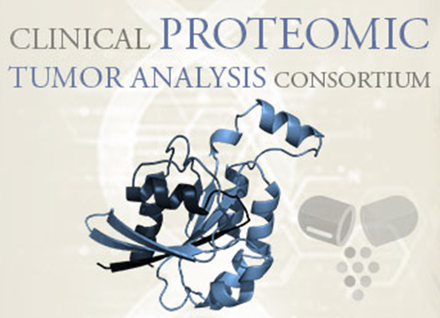



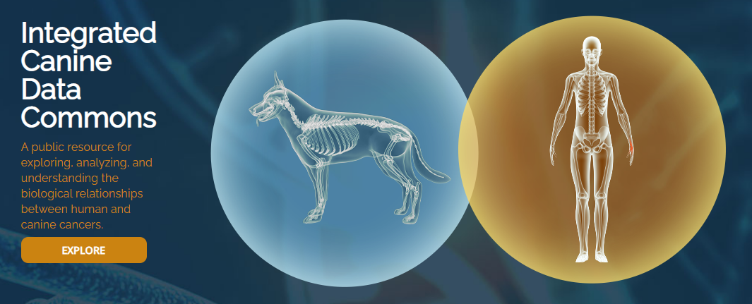


TCIA Supports Radiology and Histopathology Imaging in Major NCI Research Initiatives
National Lung Screening Trial
Quantitative Imaging Network

Slide 11
Acknowledgements
NCI Cancer Imaging Program
Lalitha K. Shankar, M.D., Ph.D.
Fredrick National Laboratory for Cancer Research
John Freymann
Justin Kirby
Ramesh Avula, Ph.D.
Brenda Fevrier-Sullivan
Pam Angelus
Luis Cordeiro
Michelle Tacconelli
University of Arkansas
Fred Prior Ph.D.
Kirk Smith
Lawrence Tarbox Ph.D.
Dwayne Dobbins
Jeff Tobler
Justin Whorton
AJ Regester
Sonya Utecht
Julie Frund
Tracy Nolan
Quasar Jarosz
Brittney Camp
Claren Freeman
Natasha Honomichl
Geri Blake
Erica Bilello
Michael Rutherford
Emory University
Ryan Birmingham
Tony Pan, Ph. D.
Stony Brook University
Joel Saltz M.D., Ph.D.
Erich Bremer
Contractors
Betty Levine
NBIA Team (NCI/FNLCR/Ellumen)
Chao Zhang
Carolyn Klinger
Tin Tran
Imaging and Radiation Oncology Core
Michael Knopp M.D., Ph.D.
Connor Nealer

